Slide 1

Inception v3 2016

Slide 2

Reference
Chapter 13 (O'Reilly) of Hands-On ML
Hvass Lab’s GitHub and Youtube
Youtube on Retrieving URL
Youtube on Inception v3 2015
Paper
Youtube
Code

Slide 3
Inception v3 2016 vs Inception v3 2015

Slide 4
Inception v3 2015

Slide 5
Inception v3 2016
Inception v3 2015

Slide 6
Inception v3 2016
Inception v3 2015
Handles only one image

Slide 7
Inception v3 2016
Inception v3 2015
Handles only one image
Handles batch images

Slide 8
Inception v3 2016
Inception v3 2015
Handles only one image
Inputs range from 0 to 255
Handles batch images

Slide 9
Inception v3 2016
Inception v3 2015
Handles only one image
Inputs range from 0 to 255
Handles batch images
Inputs range from -1 to 1

Slide 10
Code in Handson ML vs Code Here

Slide 11
Code in Handson ML

Slide 12
Code Here
Code in Handson ML

Slide 13
Code Here
Code in Handson ML
Handles only images of size 299x299x3

Slide 14
Code Here
Code in Handson ML
Handles only images of size 299x299x3
Handles images of any size

Slide 15
Code Here
Code in Handson ML
Handles only images of size 299x299x3
Handles only range 0-1
Handles images of any size

Slide 16
Code Here
Code in Handson ML
Handles only images of size 299x299x3
Handles only range 0-1
Handles images of any size
Handles both range 0-1 and 0-255

Slide 17
Inception v3 2016 Download

Slide 18
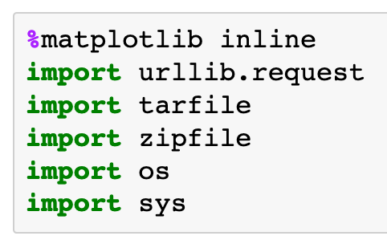

Slide 19
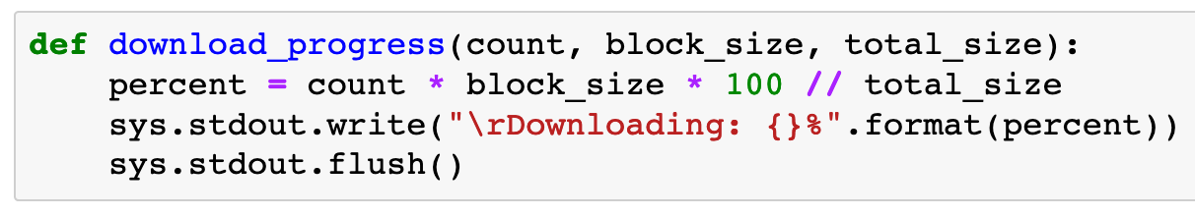

Slide 20
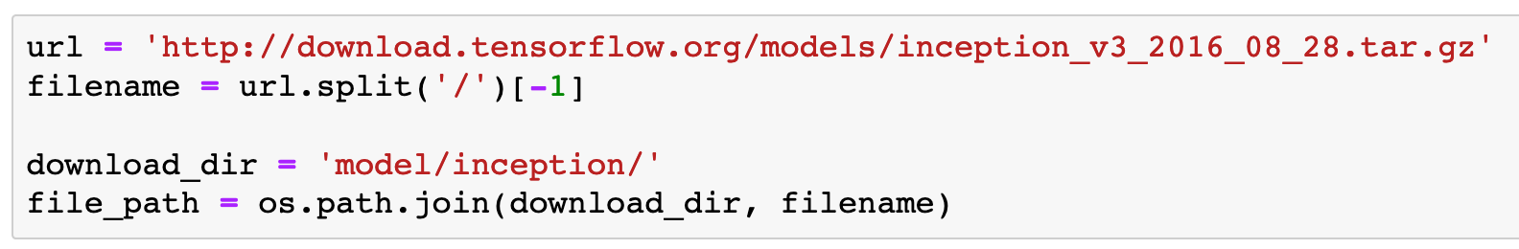

Slide 21
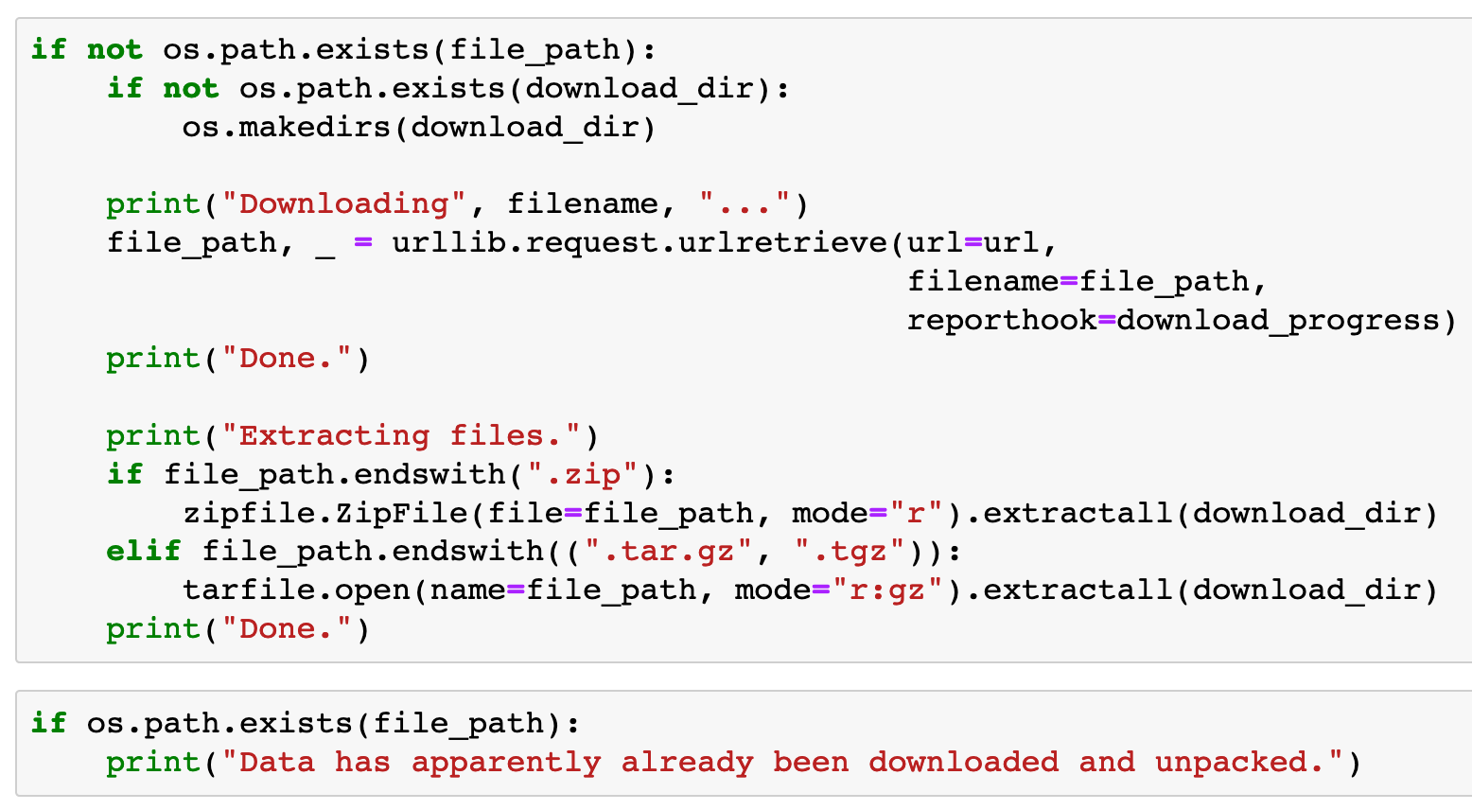

Slide 22
Construct
class_names
List

Slide 24
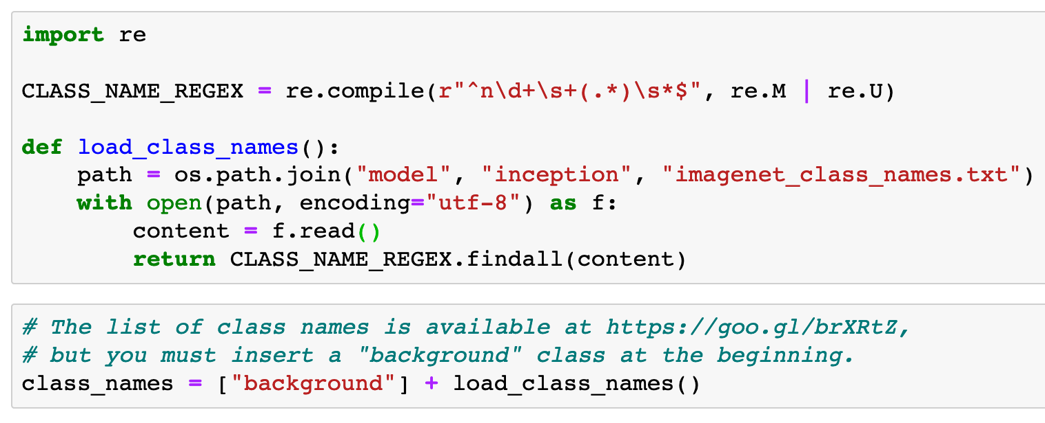


Slide 26
imagenet_class_names.txt

Slide 27
imagenet_class_names.txt

Slide 28
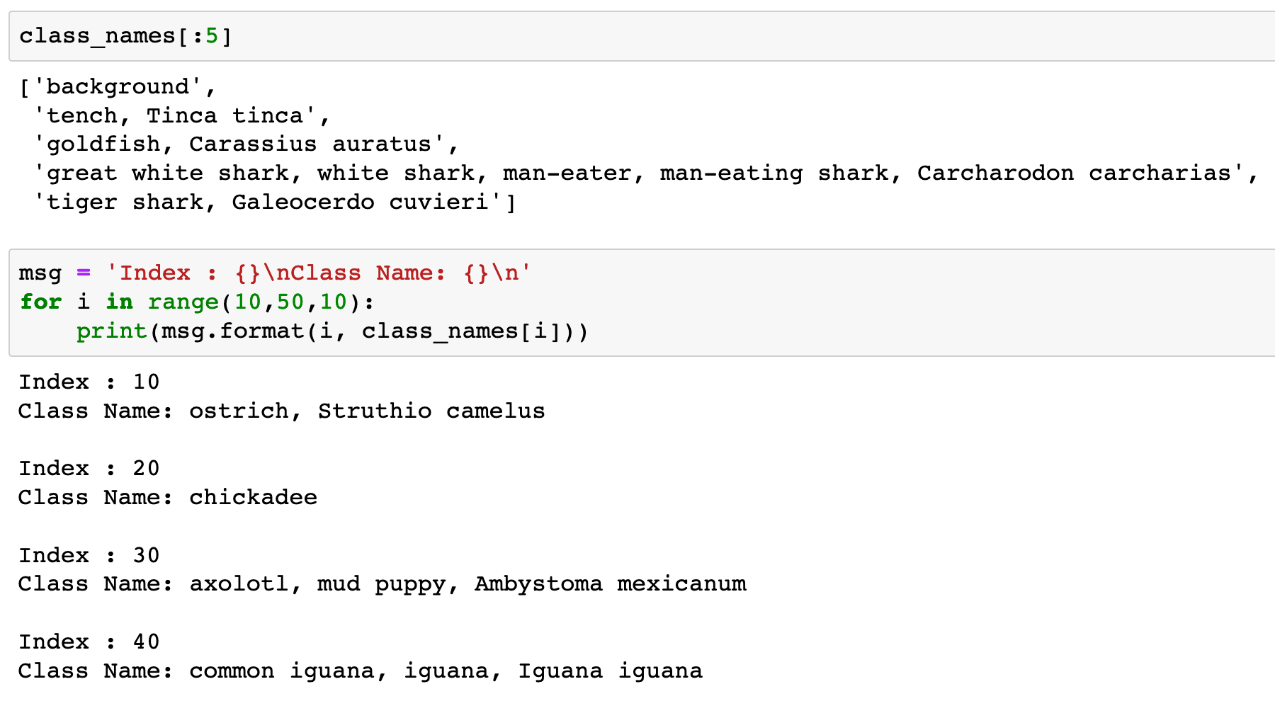

Slide 30
Restore Graph

Slide 31
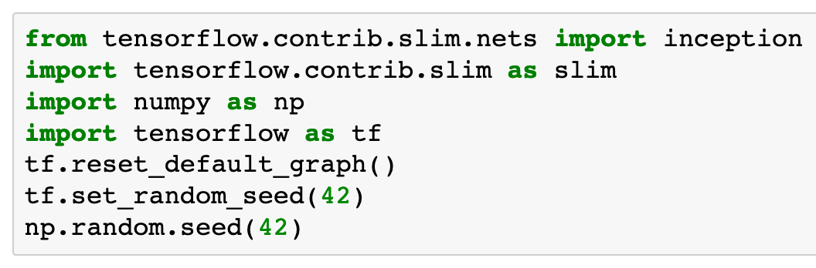

Slide 32
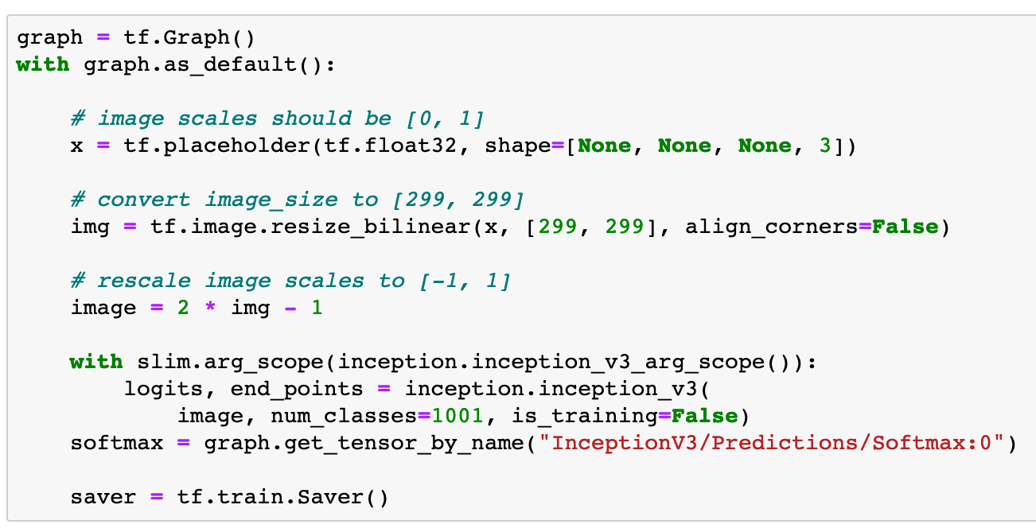

Slide 33
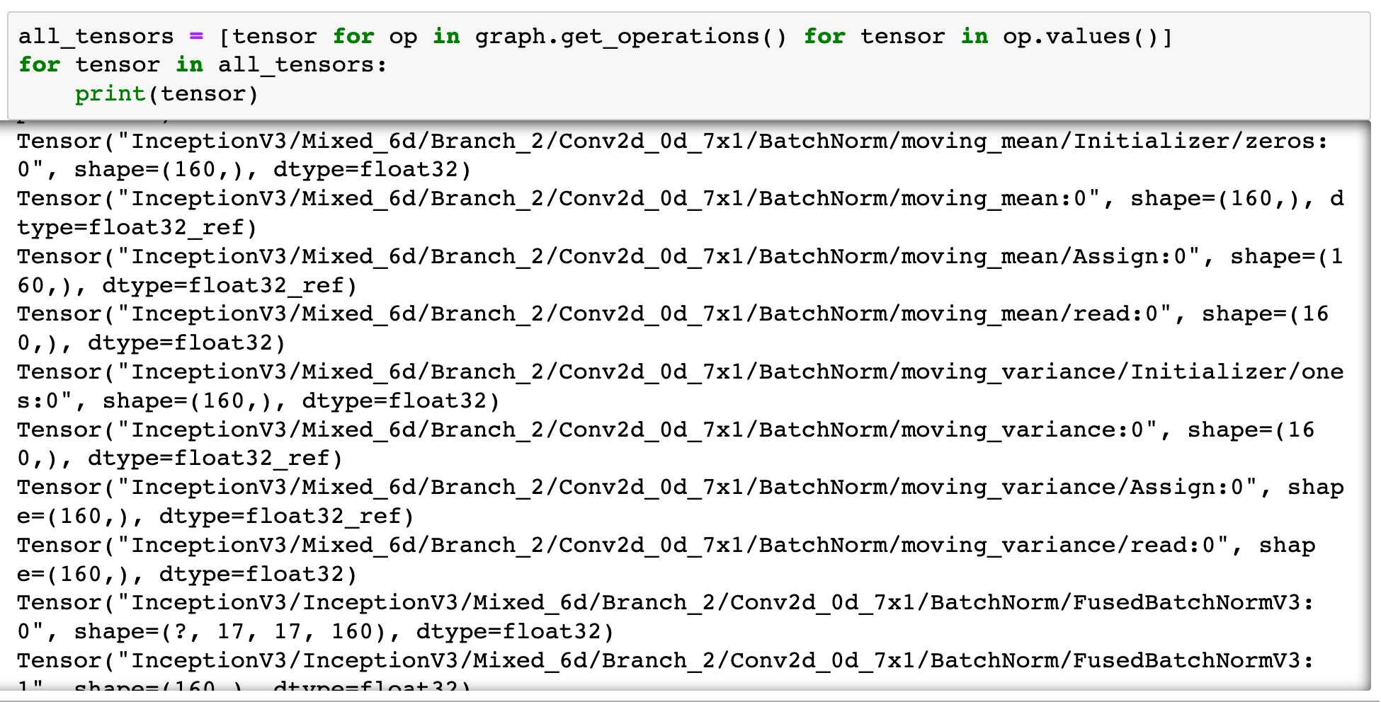

Slide 34
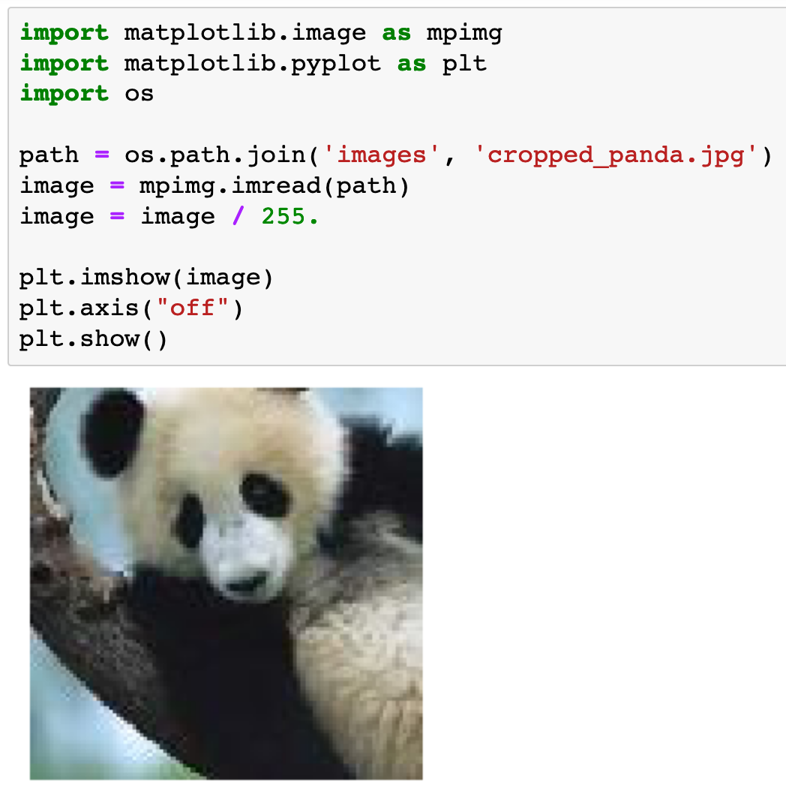

Slide 35
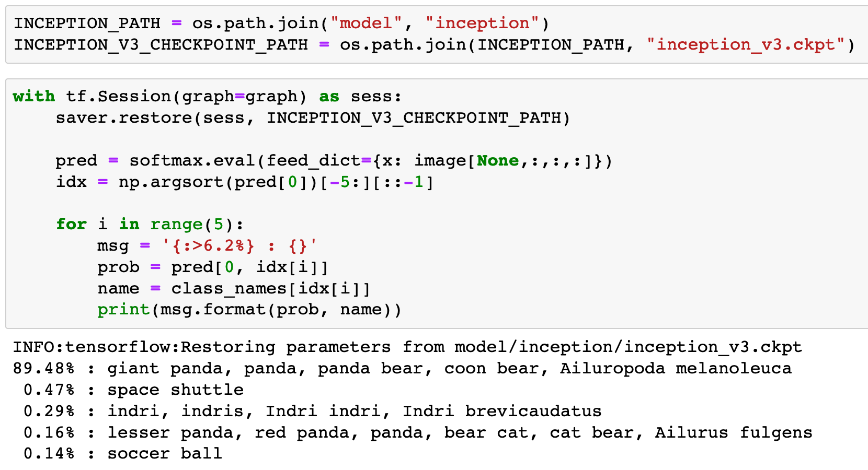

Slide 40
Test

Slide 41
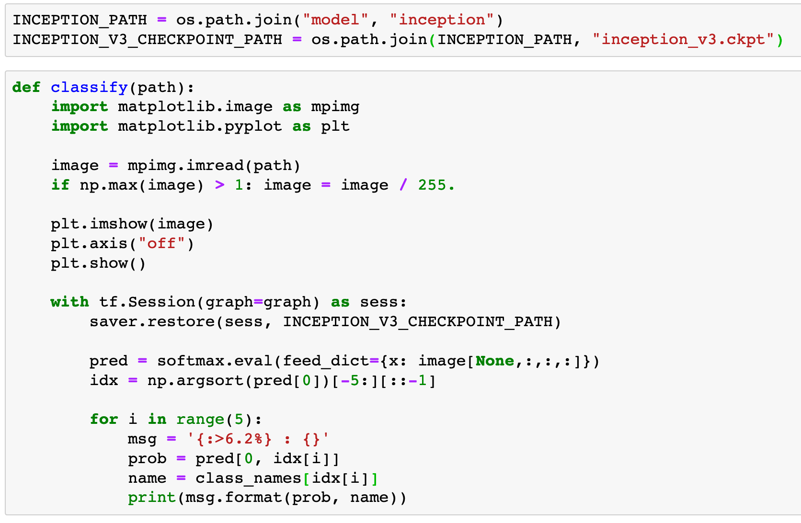

Slide 43
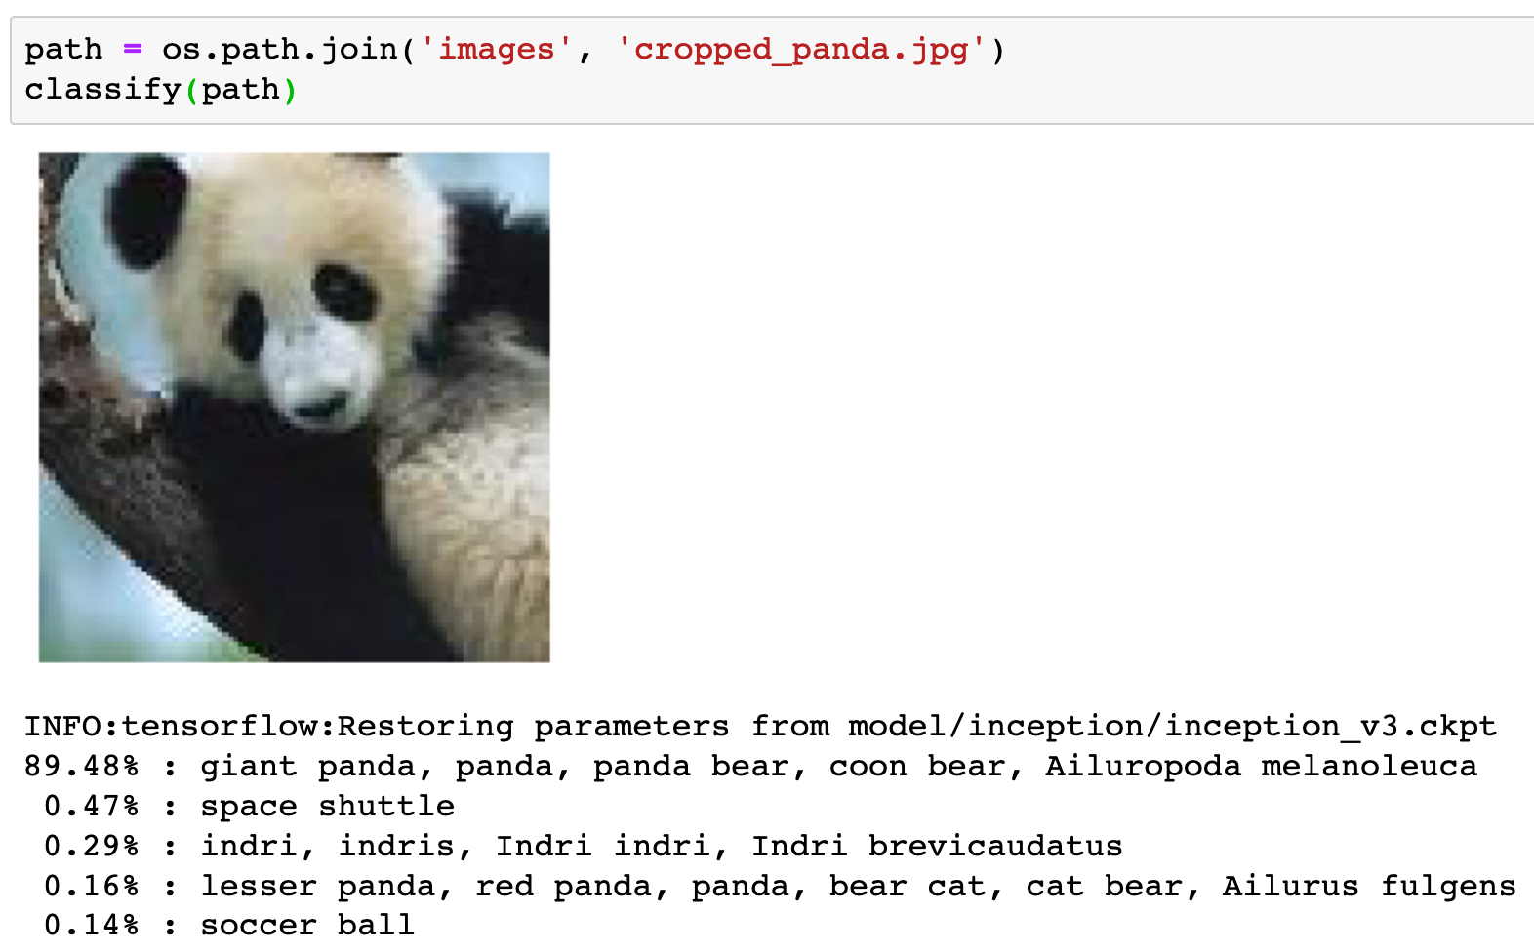

Slide 44
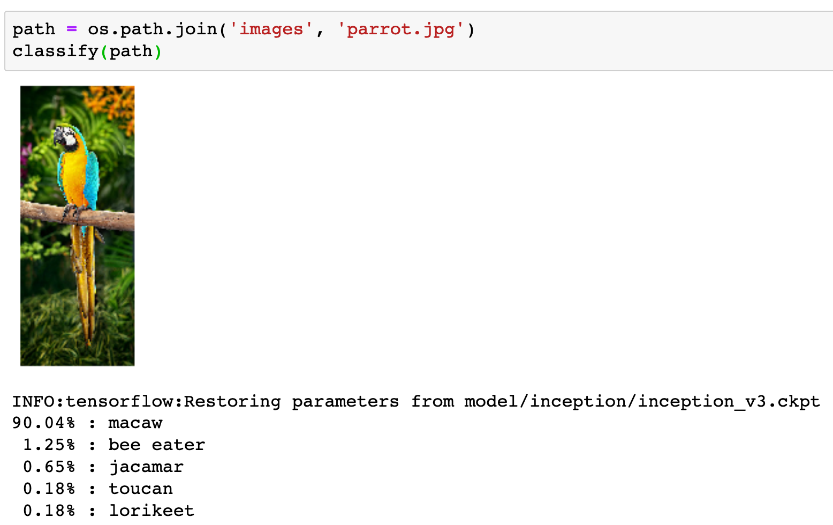

Slide 45
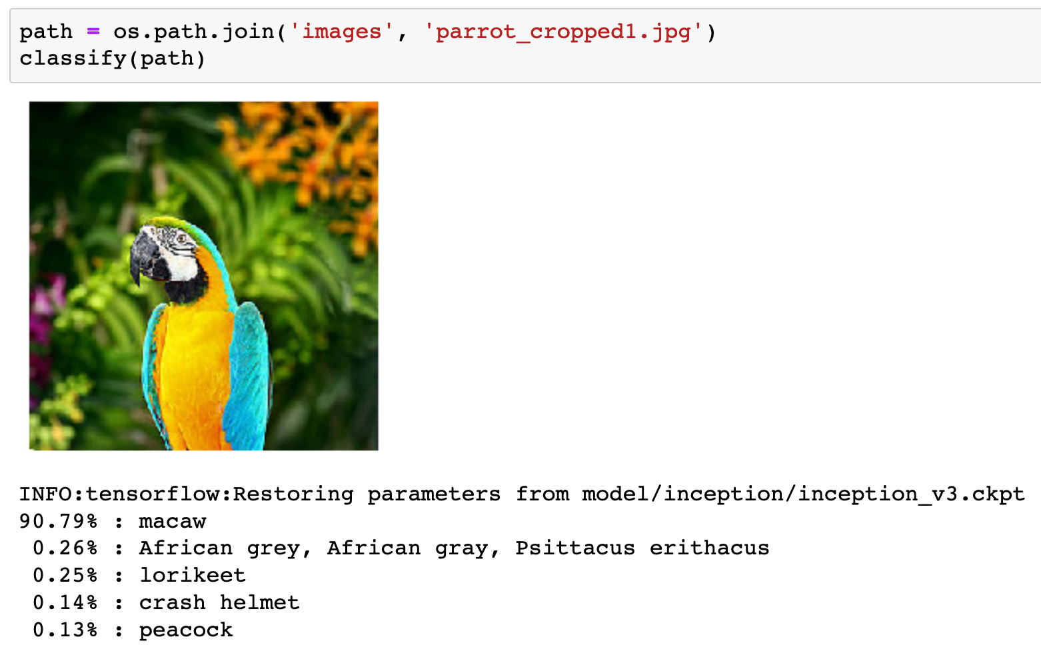

Slide 46
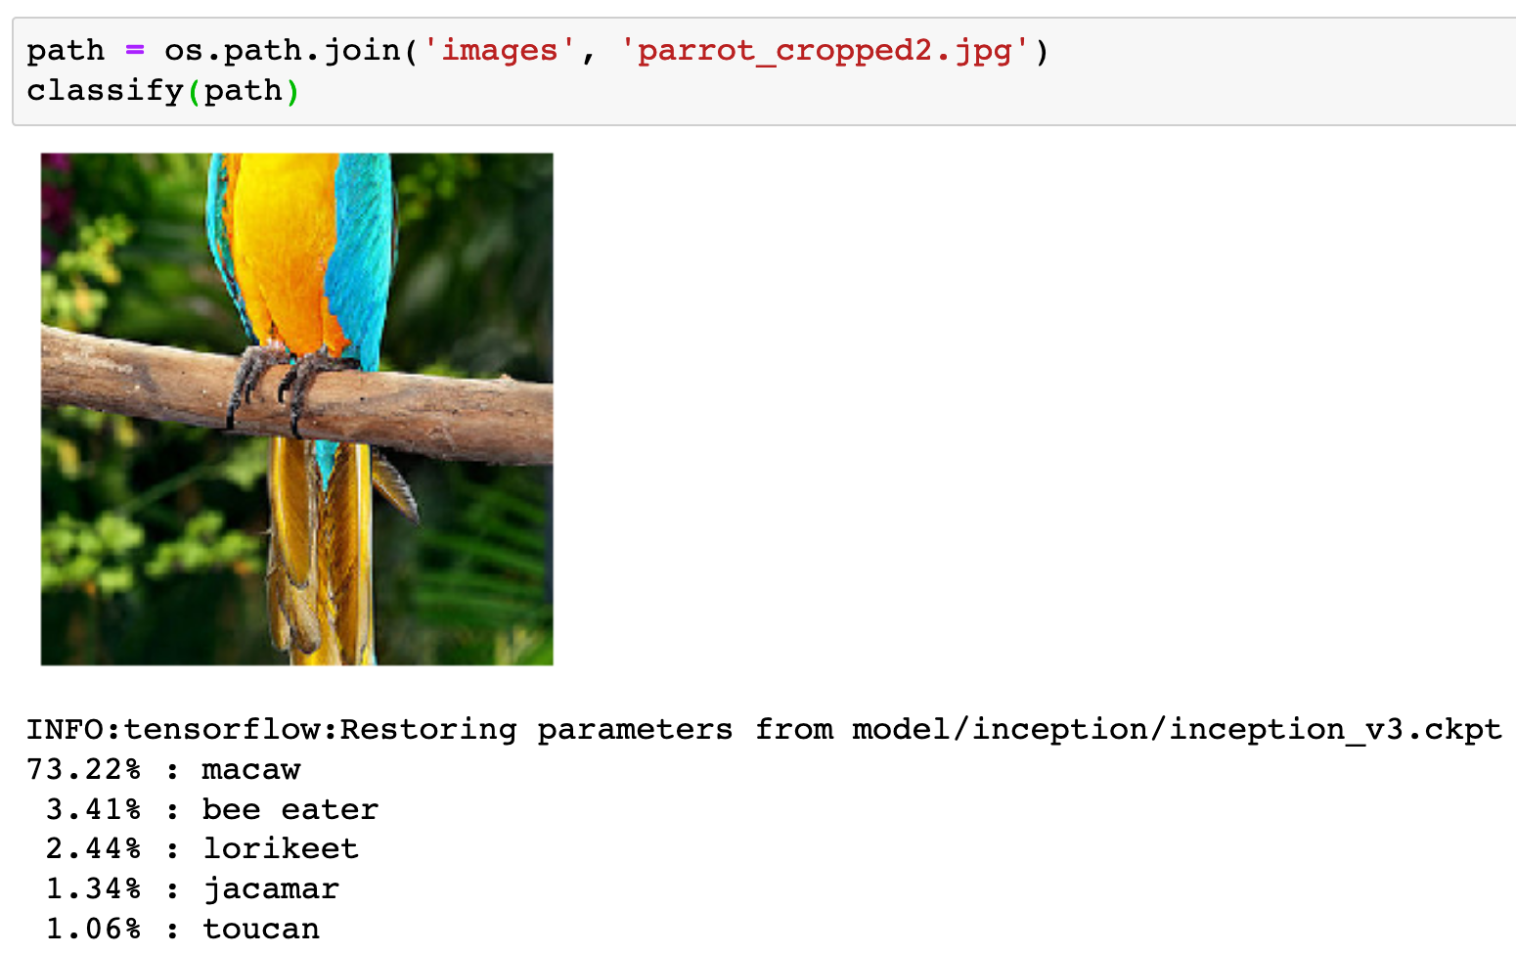

Slide 47
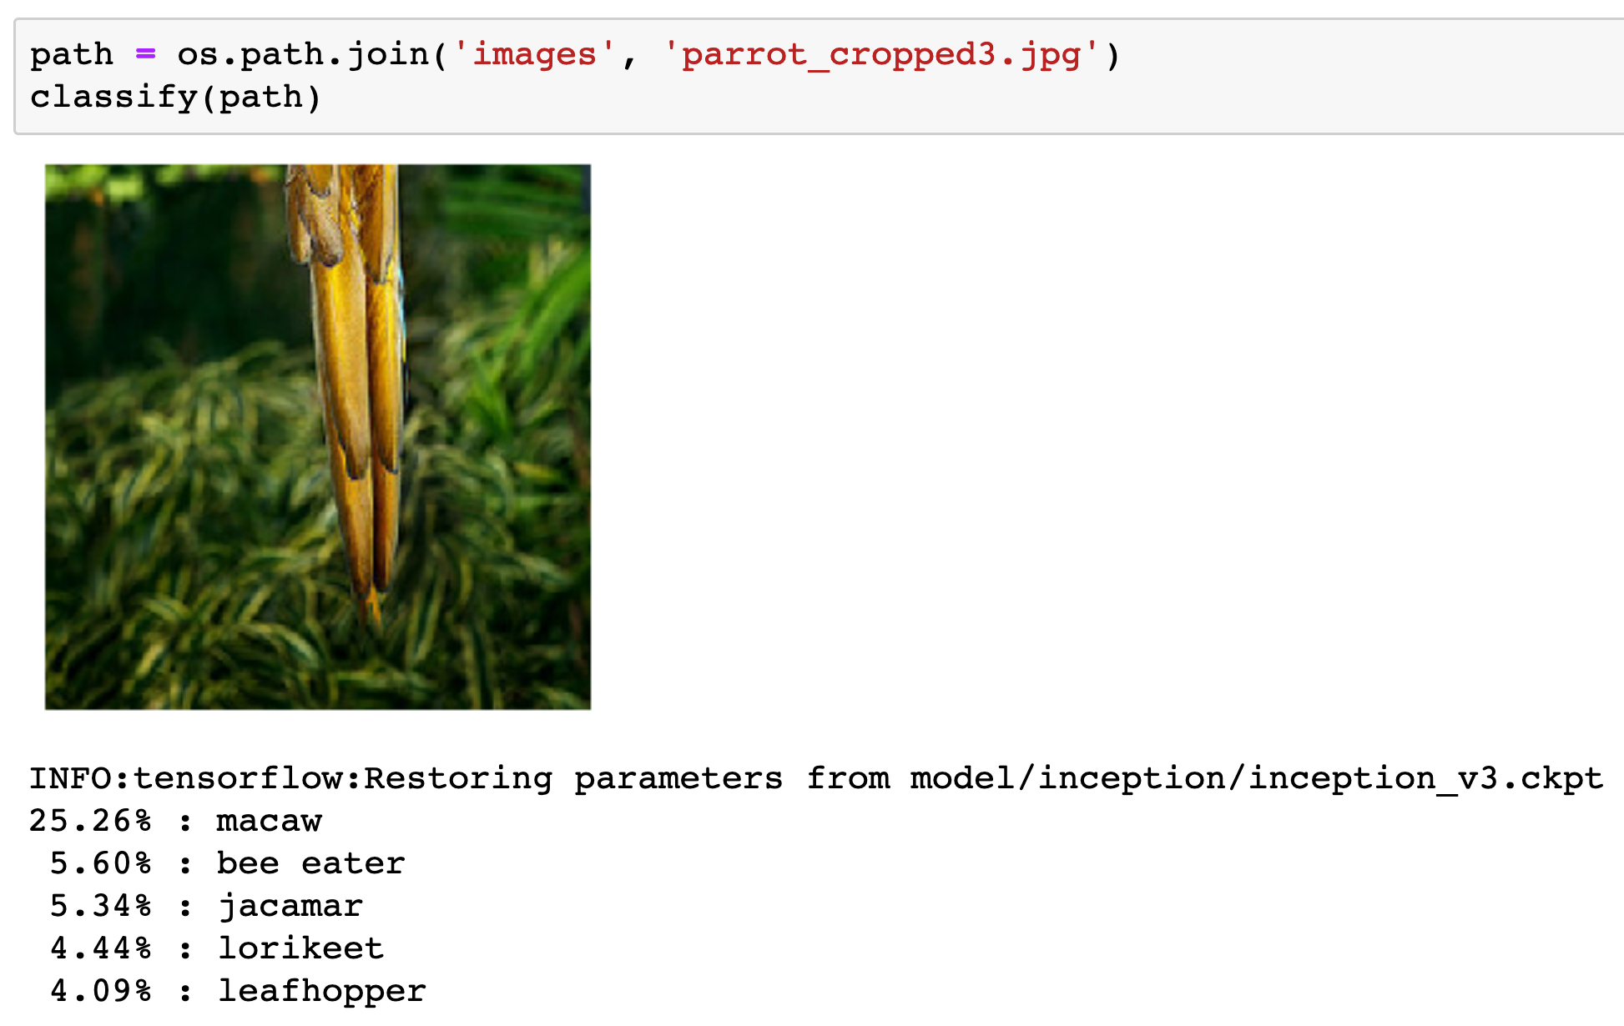

Slide 48
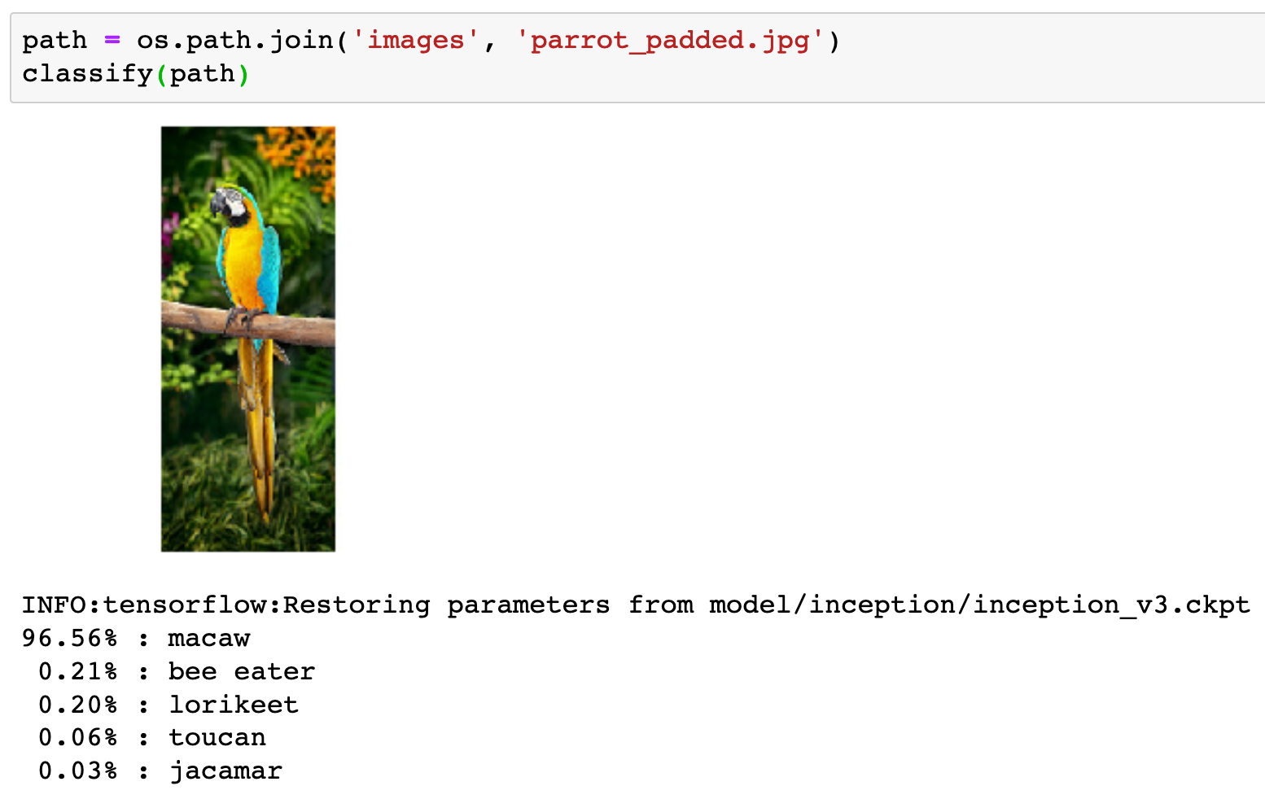

Slide 49
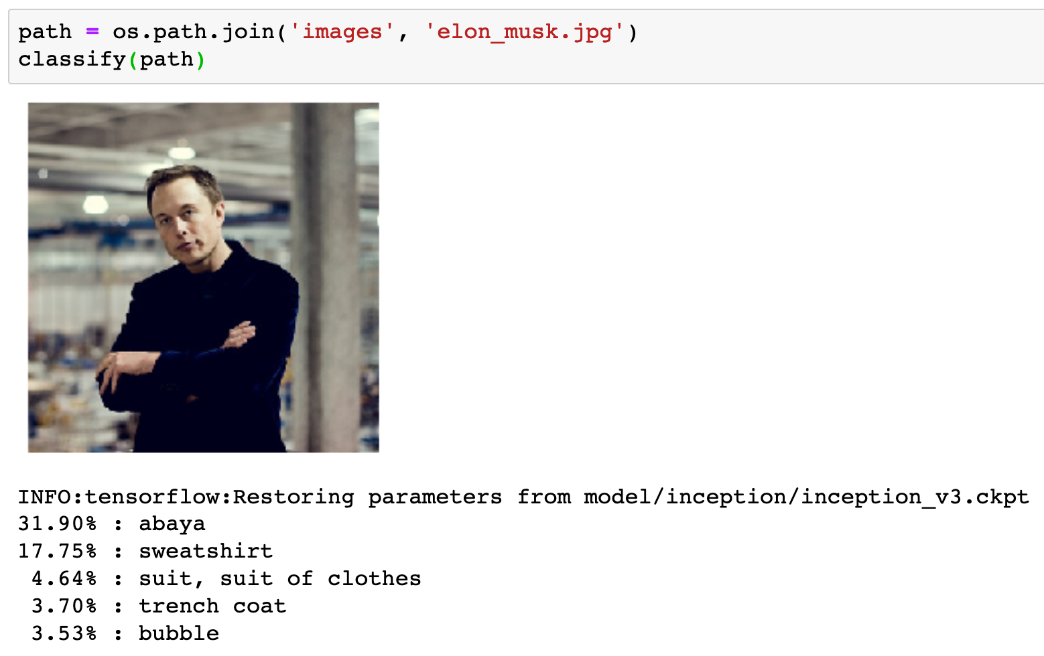

Slide 50
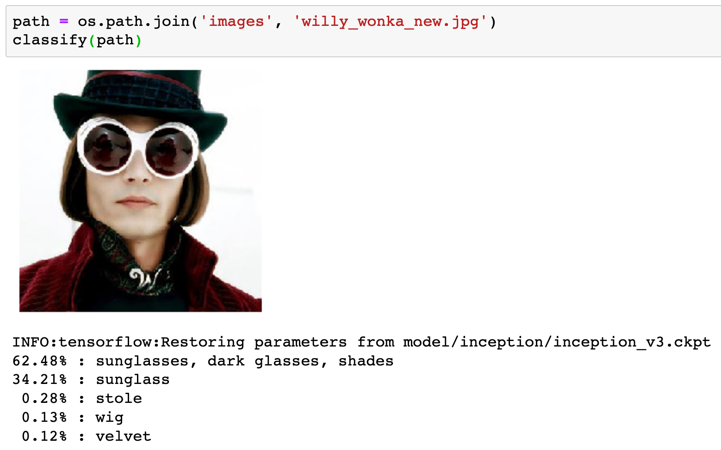

Slide 51
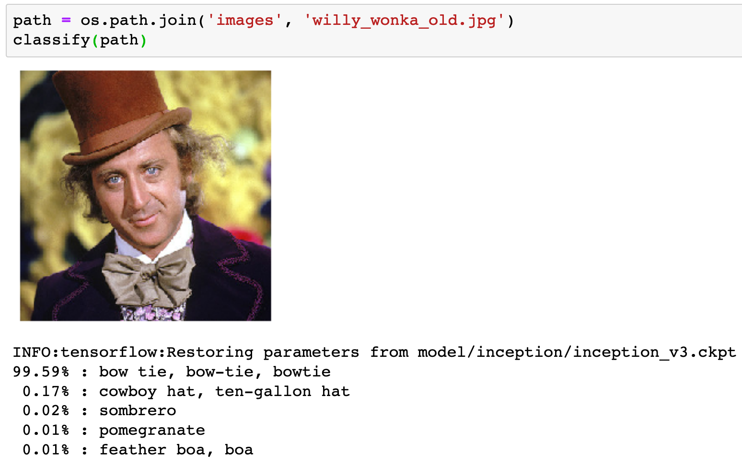

Slide 52
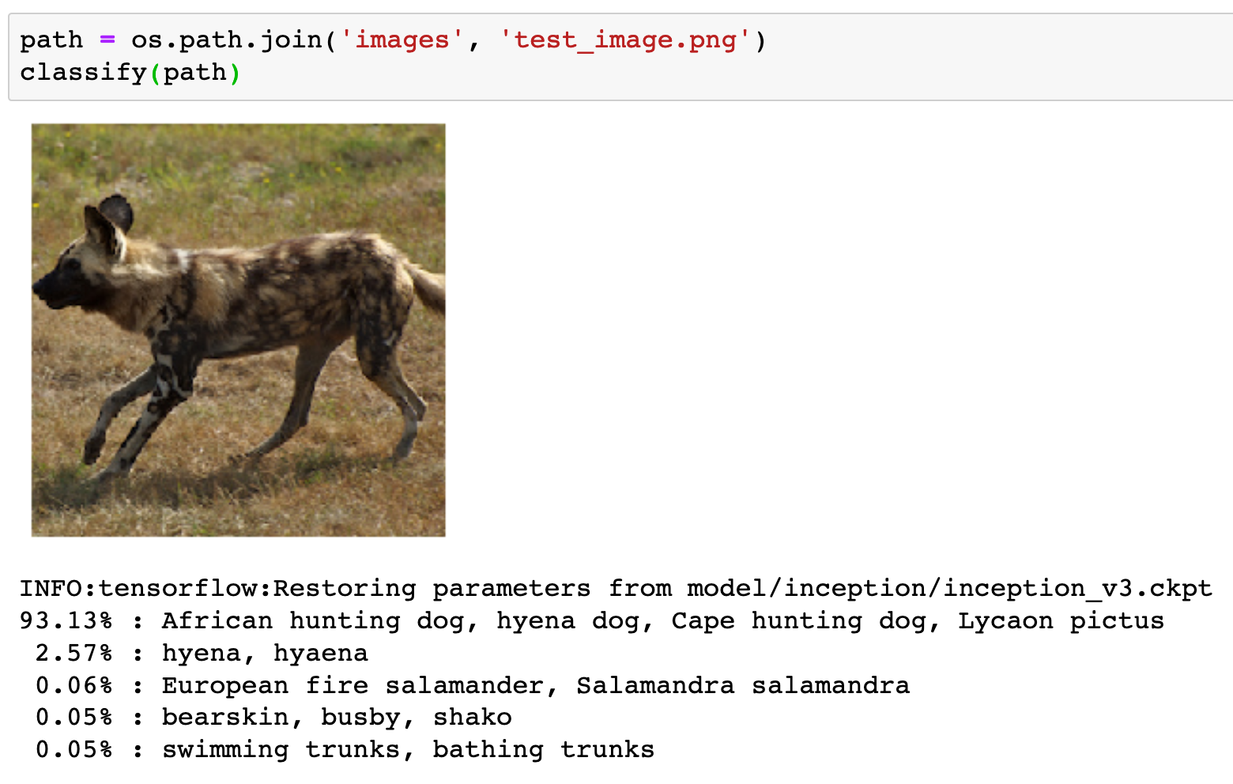

Slide 53
Now
Let’s Play with Code

